Slide 1
Valley Metro
Team 1:
Sabrina Avila, Cristina Ceniceros, Scott oathout, Philip Wewiora

Slide 2
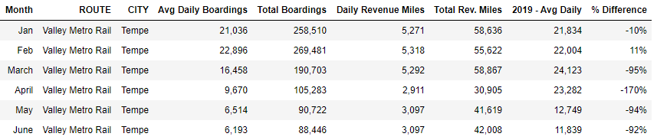
COVID Impact

Slide 3
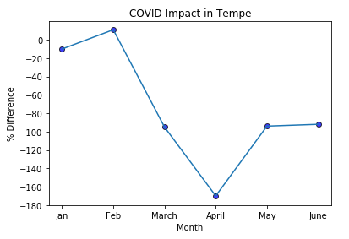
COVID Impact

Slide 4
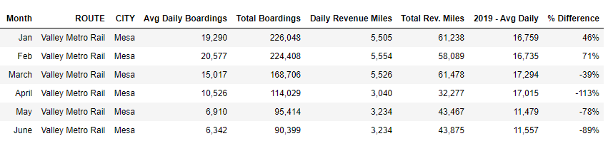
COVID Impact

Slide 5
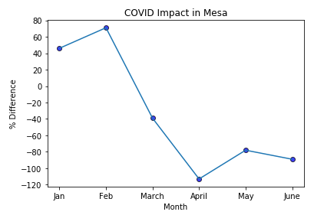
COVID Impact

Slide 6

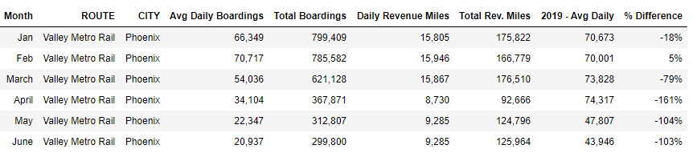
COVID Impact

Slide 7
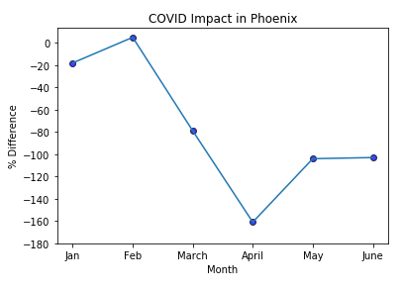
COVID Impact

